Slide 1
GSBA 511: Managerial Economics
Prof. Akbulut
Chapter 12

Slide 2
Chapter 12: Outline
Perfectly Competitive Markets
Marginal Revenue, Marginal Cost, and Profit Maximization
Choosing Output in the Short Run
The Competitive Firm’s Short-Run Supply Curve
The Short-Run Market Supply Curve
Economic Profits in the Long Run

Slide 3
Characteristics of Perfect Competition
1. Many buyers and many sellers.
2. The goods offered for sale are largely the same.
3. Firms can freely enter or exit the market.
Because of 1 & 2, each buyer and seller is a “price taker” – takes the price as given.

Slide 4
Marginal Revenue, Marginal Cost, and Profit Maximization
Profit (π): Difference between total revenue (TR) and total cost (TC).
Marginal Revenue (MR): Change in revenue resulting from a one-unit increase in output.
π(q) = TR(q) − TC(q)
more specifically TR=Pq
MR = ∆ TR / ∆q

Slide 5
Marginal Revenue, Marginal Cost, and Profit Maximization
Profit Maximization (Short Run)
Total Cost, Total Revenue
TC
TR
Profits are maximized at output where vertical distance between TR and TC is greatest.
At that output level:
Max profit = $81 at 8 units of output
$280
$175
$130
MR(q) = MC(q)
Losses
Profits
Losses
Q
3
5
8
Δπ/Δq = ΔTR/Δq − ΔTC/Δq = 0

Slide 6
Profits are maximized at output where MR(q) = MC(q)

Slide 7
Demand Curves for the Firm and the Industry
Market demand is downward sloping
Firm demand is perfectly elastic (horizontal)
P
P
Market Supply
Firm Demand
P0
P0
P = D = MR
Market Demand
Q
Q
Q₁
Q₂
Q₃

Slide 8
Profit Maximization by a Perfectly Competitive Firm MC(q) = MR = P

Slide 9
Profit Maximization
At any Q with MR > MC, increasing Q raises profit.
Q
TR
TC
Profit
MR
MC
ΔProfit = MR – MC
0
$0
$5
–$5
$10
$4
$6
1
10
9
1
10
6
4
2
20
15
5
At any Q with MR < MC, reducing Q raises profit.
10
8
2
3
30
23
7
10
10
0
4
40
33
7
10
12
–2
5
50
45
5

Slide 10
Marginal Cost, Marginal Revenue, and Price Graph
P
Marginal Cost
MC > P,
decrease output to increase total profit
MC = P
$35
P = D = MR
MC < P,
increase output to increase total profit
Q
MC = P at 8 units,
total profit is maximized

Slide 11
A C T I V E L E A R N I N G Identifying a firm’s profit
0
Determine this firm’s total profit.
Identify the area on the graph that represents the firm’s profit.
A competitive firm
Costs, P
MC
P = $10
MR
ATC
$6
Q
50

Slide 12
A C T I V E L E A R N I N G Answers
0
A competitive firm
Costs, P
Profit per unit = P – ATC = $10 – 6 = $4
MC
P = $10
MR
profit
ATC
$6
Total profit = (P – ATC) x Q = $4 x 50 = $200
Q
50

Slide 13
Determining Profits Graphically: A Firm with Profit
P
Since P>ATC
at the profit maximizing quantity, this
firm is earning profits
MC
MC = MR
ATC
P
Profits
P = D = MR
AVC
ATC
ATC at Q_{profit max}
Q
Q_{profit max}

Slide 14
Determining Profits Graphically: A Firm with Losses
Since P<ATC
at the profit maximizing quantity, this
firm is earning losses
P
MC
ATC at Q_{profit max}
ATC
AVC
ATC
Losses
P = D = MR
P
MC = MR
Q
Q_{profit max}

Slide 15
Determining Profits Graphically: The Shutdown Decision
Shut-Down Rule: The firm should shut down (not produce) if P < AVC at the profit-maximizing output level.
If a firm shuts down, it still has to pay its fixed costs.
P
MC
ATC
AVC
P_{Shutdown}
P = D = MR
Q
Q_{profit max}

Slide 16

The Competitive Firm’s Short-Run Supply Curve
In the short run, the firm chooses its output so that MC = P, as long as the firm covers its AVC.
The firm’s short-run supply curve is the portion of the marginal cost curve for which marginal cost is greater than average variable cost.
P
MC
ATC
AVC
Q
Q_{profit max}

Slide 17
Short-Run Market Supply and Demand Graph
P
Market
P
Firm
MC
Market Supply
ATC
P
P
P = D = MR
Profits
ATC
Market Demand
Q
Q
Q_{profit max}

Slide 18
Market Response to an Increase in Demand
P
Market
P
Firm
MC
S_{0(SR)}
S_{1(SR)}
ATC
2
P₁
P₁
1
2
SR Profits
1
2
P₀
P₀
1
1
D₁
1
2
D₀
2
Q
Q
Q₀
Q₁
Q₂
Q_{0,2}
Q₁

Slide 19
Long-Run Competitive Equilibrium
At long run equilibrium, economic profits are zero
Firm is earning a normal return on its investment— i.e., it is doing as well as it could by investing its money elsewhere.
Profits create incentives for new firms to enter, market supply increases, and the price falls until zero profits are made
The existence of losses causes firms to leave the industry, market supply decreases, and the price increases until losses are zero

Slide 20
Long-Run Market Supply
If the long-run industry supply curve is perfectly elastic, the market is a constant-cost industry
If the long-run industry supply curve is upward sloping, the market is an increasing-cost industry
If the long-run industry supply curve is downward sloping, the market is a decreasing-cost industry
In the short run, the price does more of the adjusting, and in the long run, more of the adjustment is done by quantity

Slide 21
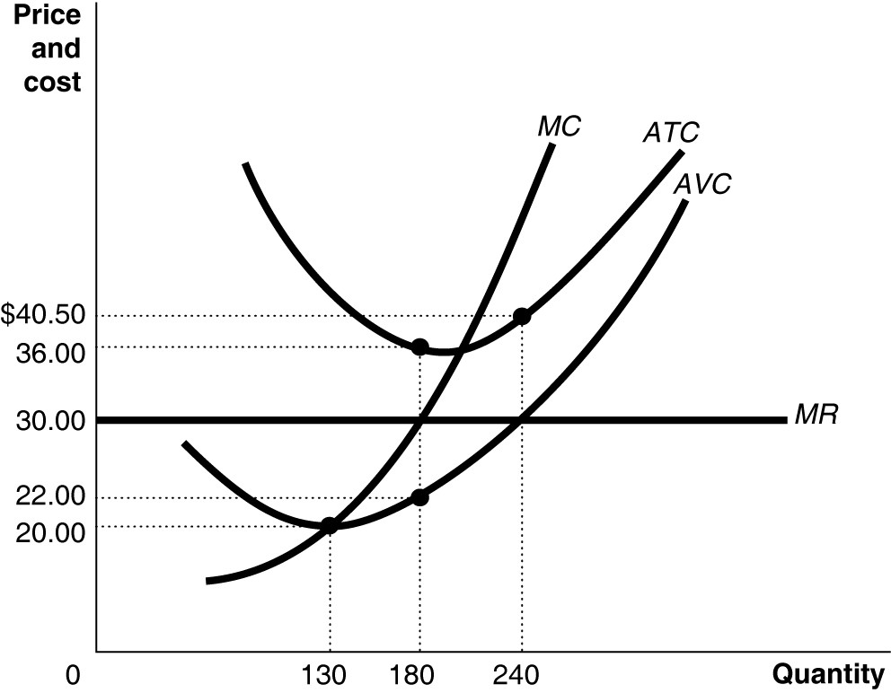
Active Learning
Perfectly Competitive Firm
Market Price =
Profit-maximizing quantity =
Profit =
Fixed Cost =

Slide 22
Active Learning
Perfectly Competitive Firm
Market Price = $30
Profit-maximizing quantity = 180
Profit = - $1,080
Fixed Cost = $2,520

